Slide 1

Setting up your ML application
Train/dev/test
sets
deeplearning.ai

Slide 2

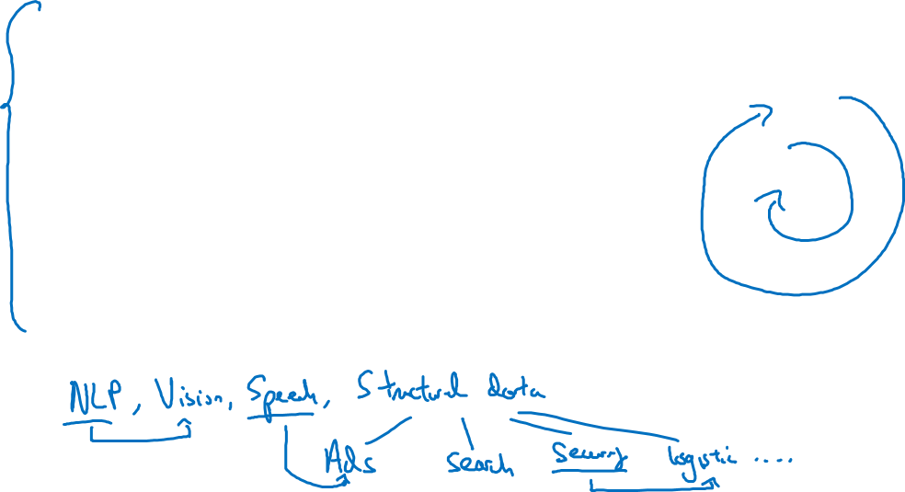
Applied ML is a highly iterative process
# layers
Idea
# hidden units
learning rates
activation functions
…
Experiment
Code

Slide 3
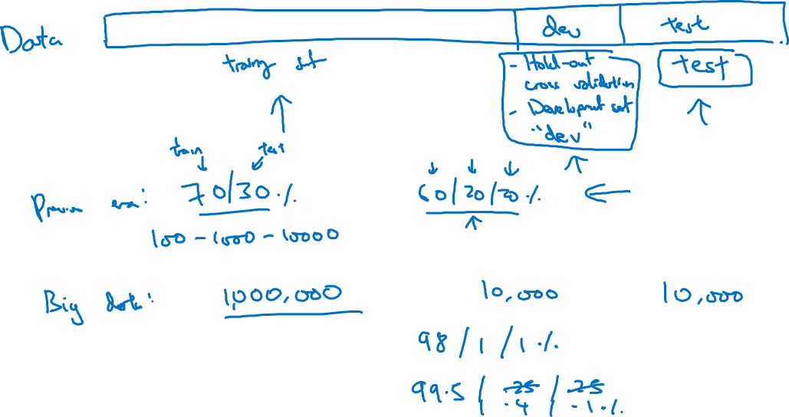
Train/dev/test sets

Slide 4
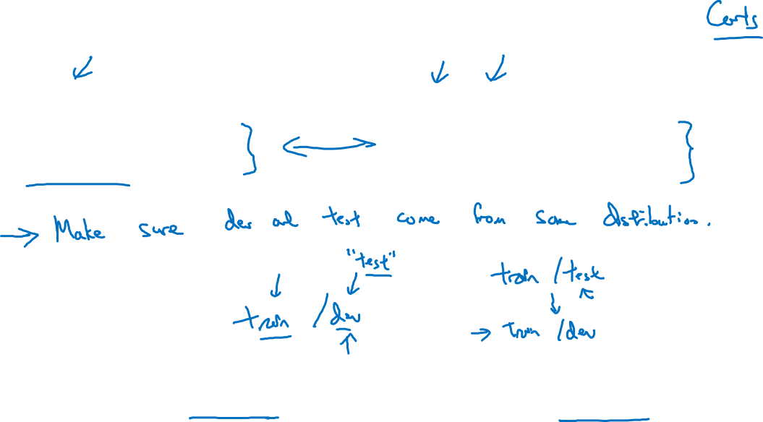
Mismatched train/test distribution
Training set:
Cat pictures from webpages
Dev/test sets:
Cat pictures from users using your app
Not having a test set might be okay. (Only dev set.)

Slide 5
Setting up your ML application
Bias/Variance
deeplearning.ai

Slide 6
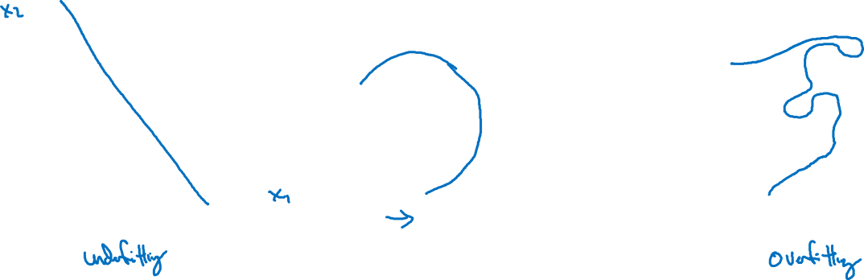
Bias and Variance
high bias
“just right”
high variance

Slide 7

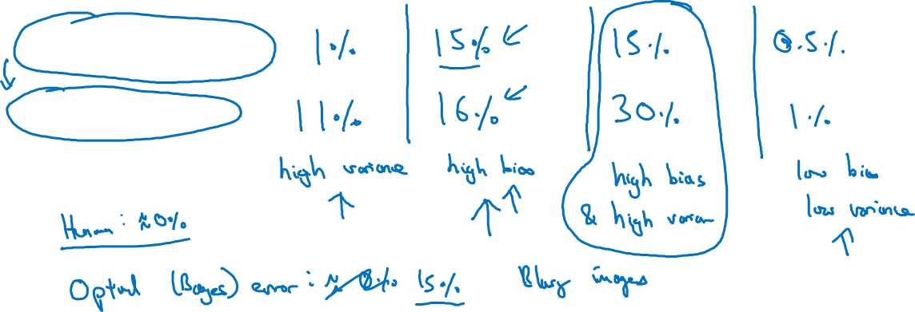
Bias and Variance
Cat classification
Train set error:
Dev set error:

Slide 8
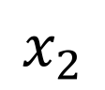
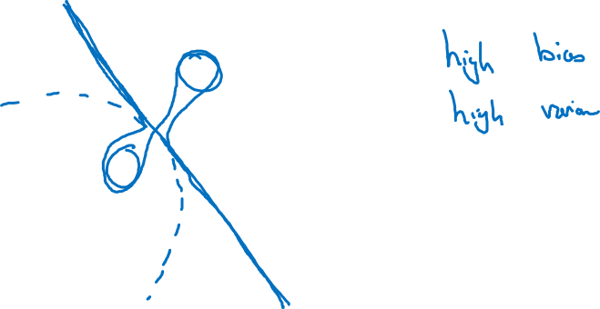
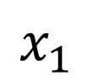
High bias and high variance
$$x_{2}$$
$$x_{1}$$

Slide 9
Setting up your ML application
Basic “recipe”
for machine learning
deeplearning.ai

Slide 10
Basic “recipe” for machine learning

Slide 11
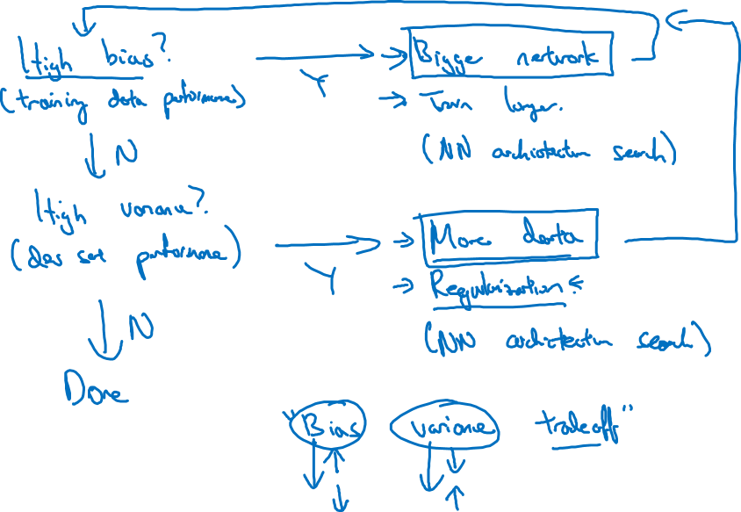
Basic recipe for machine learning

Slide 12
Regularizing your neural network
Regularization
deeplearning.ai

Slide 13
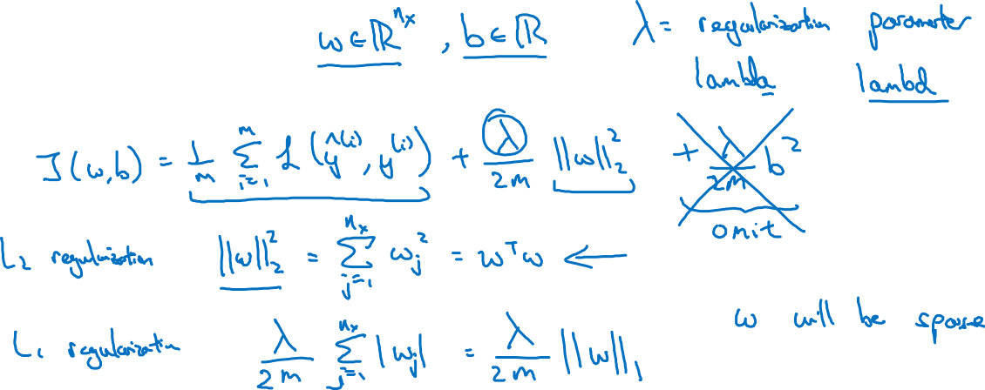
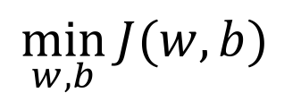
Logistic regression
$$\min_{w,b}{J(w,b)}$$

Slide 14
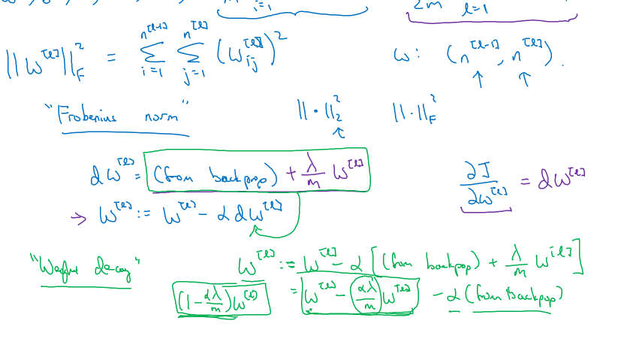
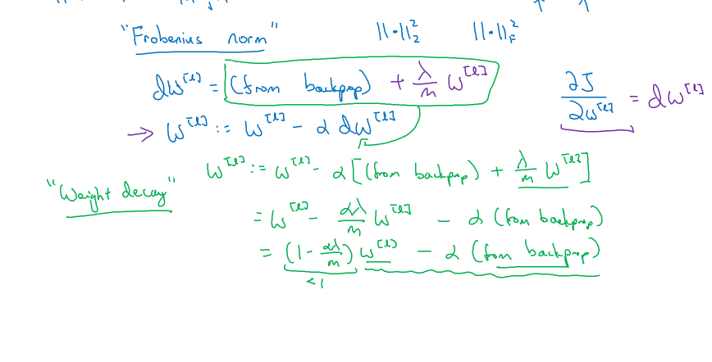
Neural network

Slide 15
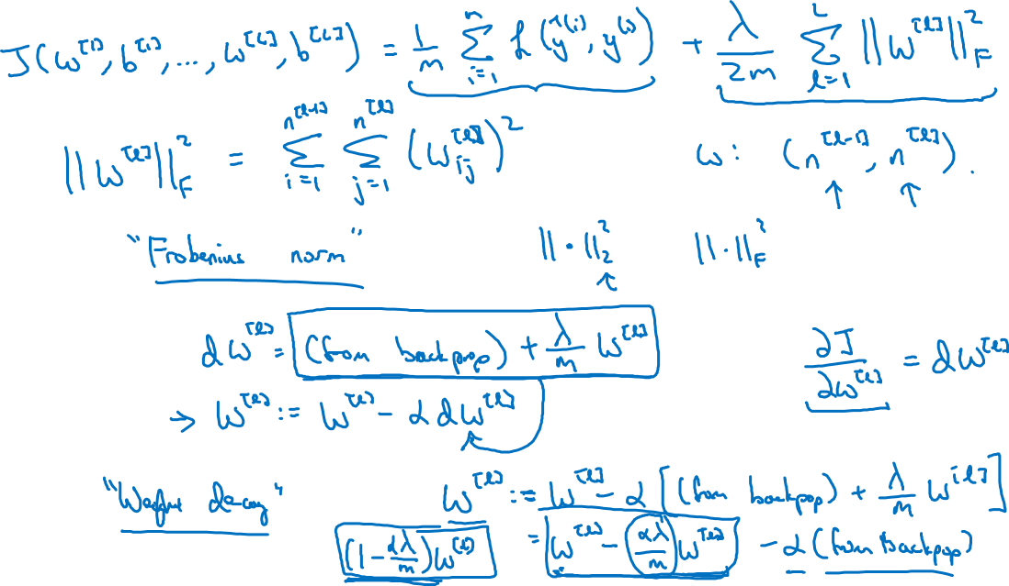
Neural network

Slide 16
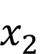
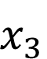
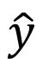
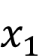
How does regularization prevent overfitting?
$$x_{1}$$
$$x_{2}$$
$$\hat{y}$$
$$x_{3}$$

Slide 17
How does regularization prevent overfitting?

Slide 18
Regularizing your neural network
Why regularization reduces overfitting
deeplearning.ai

Slide 19
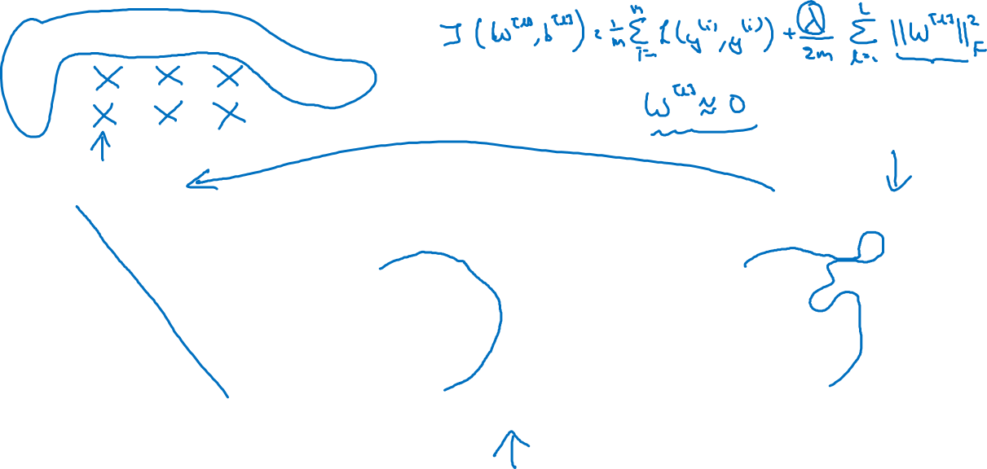
How does regularization prevent overfitting?
$$x_{1}$$
$$x_{2}$$
$$\hat{y}$$
$$x_{3}$$
high bias
“just right”
high variance

Slide 20
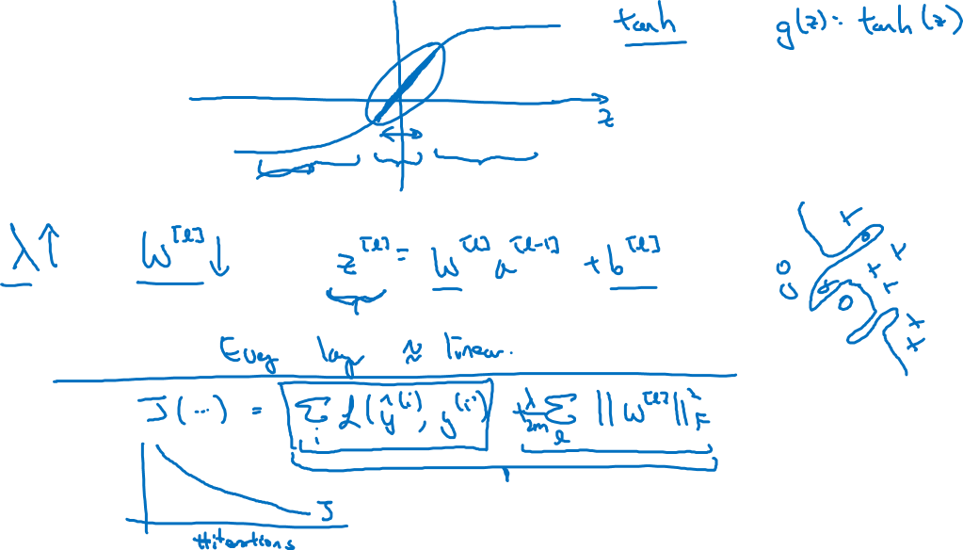
How does regularization prevent overfitting?

Slide 21
Regularizing your neural network
Dropout
regularization
deeplearning.ai

Slide 22
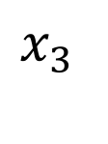
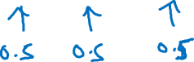
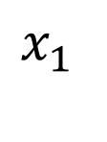
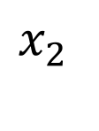
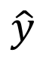
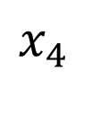
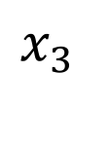
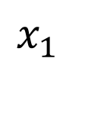
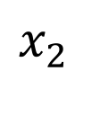
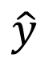
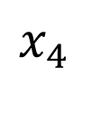
Dropout regularization
$$x_{1}$$
$$x_{1}$$
$$x_{2}$$
$$x_{2}$$
$$\hat{y}$$
$$\hat{y}$$
$$x_{3}$$
$$x_{3}$$
$$x_{4}$$
$$x_{4}$$

Slide 23
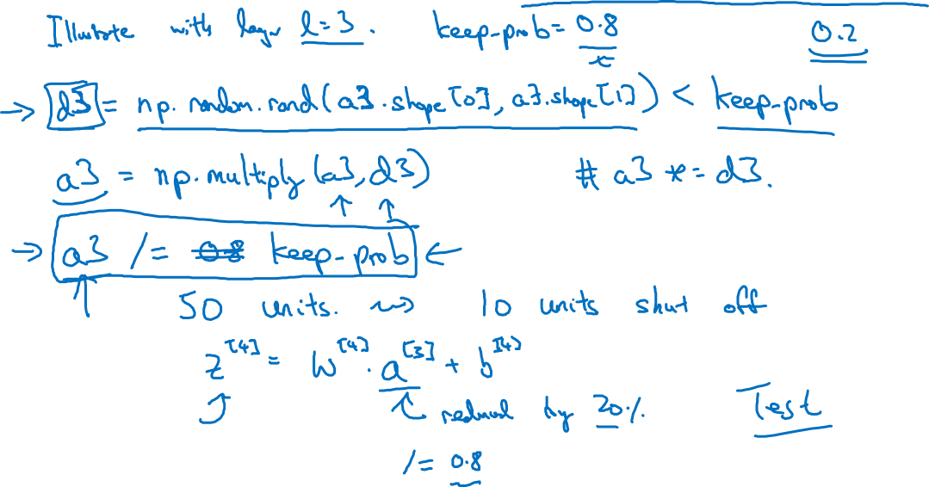
Implementing dropout (“Inverted dropout”)

Slide 24
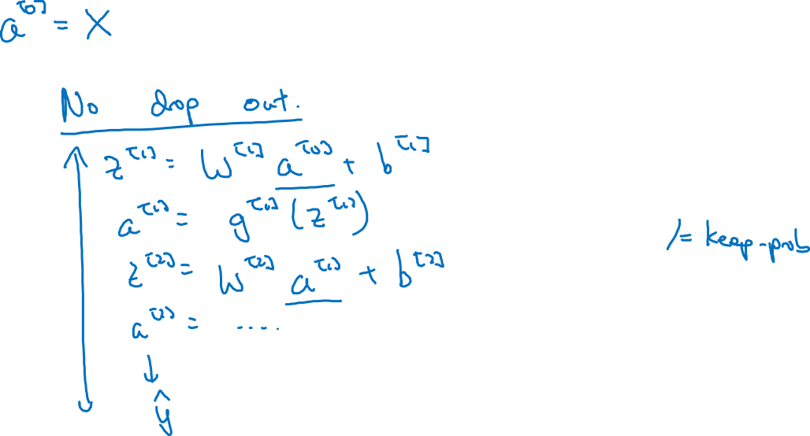
Making predictions at test time

Slide 25
Regularizing your neural network
Understanding
dropout
deeplearning.ai

Slide 26
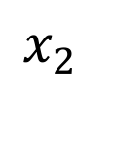
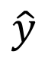
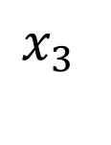
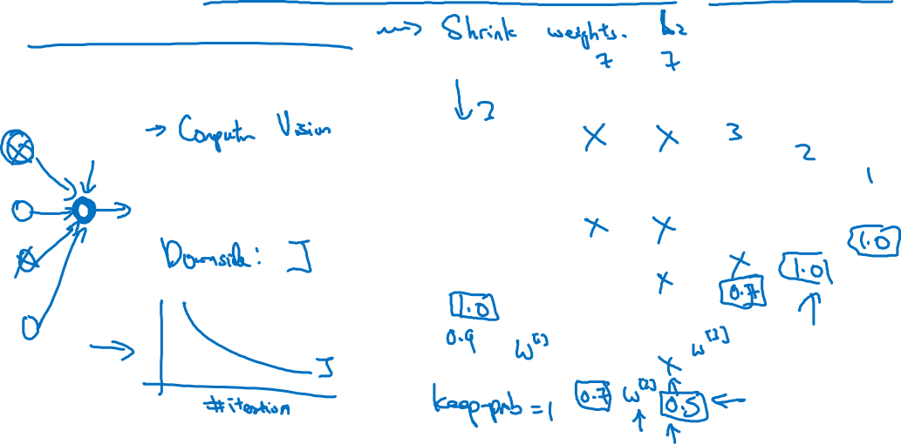
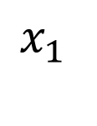
Why does drop-out work?
Intuition: Can’t rely on any one feature, so have to
spread out weights.
$$x_{1}$$
$$x_{2}$$
$$\hat{y}$$
$$x_{3}$$

Slide 27
Regularizing your neural network
Other regularization
methods
deeplearning.ai

Slide 28




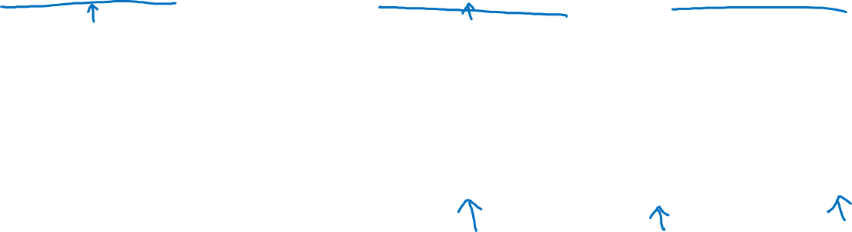
Data augmentation
4

Slide 29
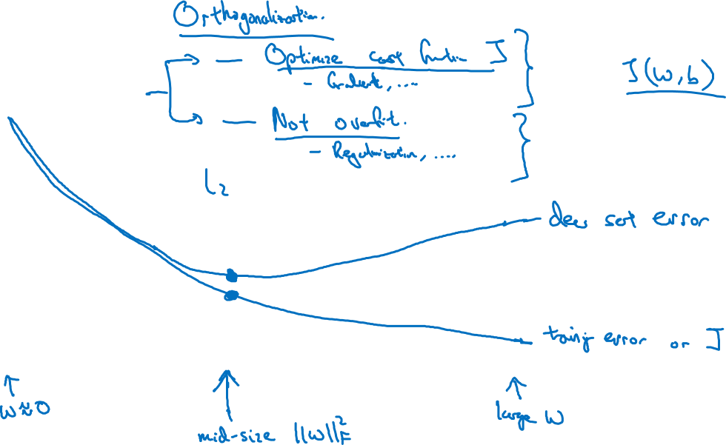
Early stopping
# iterations

Slide 30
Setting up your optimization problem
Normalizing inputs
deeplearning.ai

Slide 31
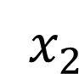
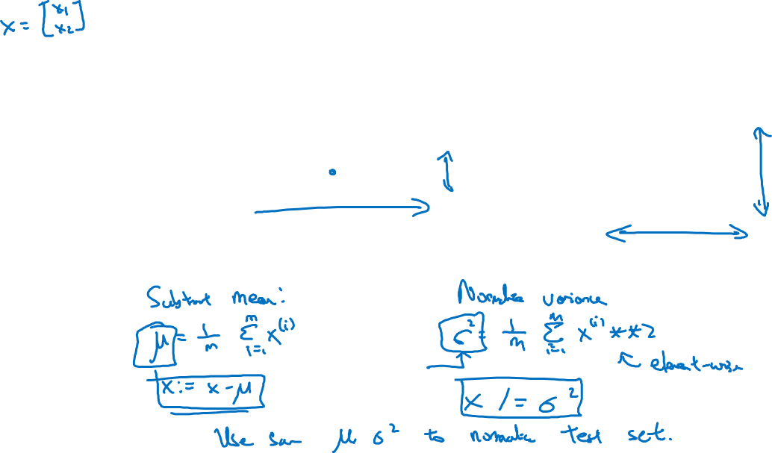
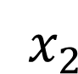
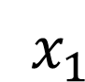
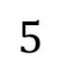
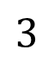
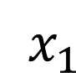
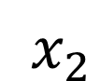
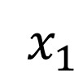
Normalizing training sets
$x_{2}$
$x_{2}$
$$3$$
$x_{2}$
$x_{1}$
$x_{1}$
$x_{1}$
$$5$$

Slide 32
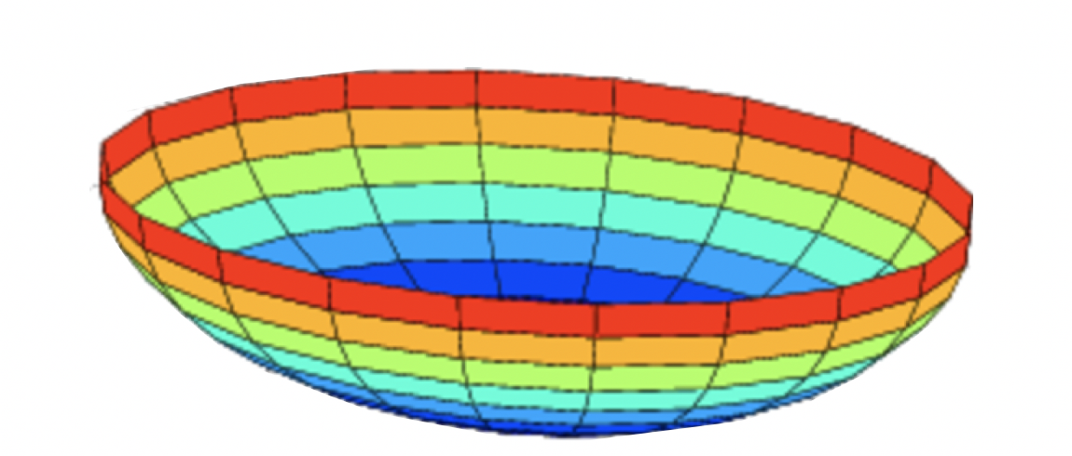















Why normalize inputs?
$$J\left(w,b\right)=\frac{1}{m}$$
$$\sum_{i=1}^{m}{ }$$
$$ℒ ({\hat{y}}^{\left(i\right)},y^{(i)})$$
Unnormalized:
Normalized:
$$J$$
$$J$$
$$w$$
$$w$$
$$b$$
$$b$$
$$b$$
$$b$$
$$w$$
$$w$$

Slide 33
Setting up your optimization problem
Vanishing/exploding
gradients
deeplearning.ai

Slide 34




Vanishing/exploding gradients
$x_{1}$
$$\hat{y}$$
$x_{2}$
=

Slide 35







Single neuron example
$x_{1}$
$x_{2}$
$$\hat{y}$$
$x_{3}$
$x_{4}$
$$a=g(z)$$

Slide 36
Note: the font is smaller than usual here so it fits nicely.
Setting up your optimization problem
Numerical approximation
of gradients
deeplearning.ai

Slide 37


Checking your derivative computation
$$f$$

Slide 38


Checking your derivative computation
$$f$$

Slide 39
Setting up your optimization problem
Gradient Checking
deeplearning.ai

Slide 40

Gradient check for a neural network
Take $W^{\left[1\right]},b^{[1]},…,W^{\left[L\right]},b^{\left[L\right]}$ and reshape into a big vector $θ.$
Take ${dW}^{\left[1\right]},{db}^{[1]},…,{dW}^{\left[L\right]},{db}^{\left[L\right]}$ and reshape into a big vector $dθ.$

Slide 41

Gradient checking (Grad check)

Slide 42
Setting up your optimization problem
Gradient Checking
implementation notes
deeplearning.ai

Slide 43


Gradient checking implementation notes
- Don’t use in training – only to debug
- If algorithm fails grad check, look at components to try to identify bug.
- Remember regularization.
- Doesn’t work with dropout.
- Run at random initialization; perhaps again after some training.

